Slide 1
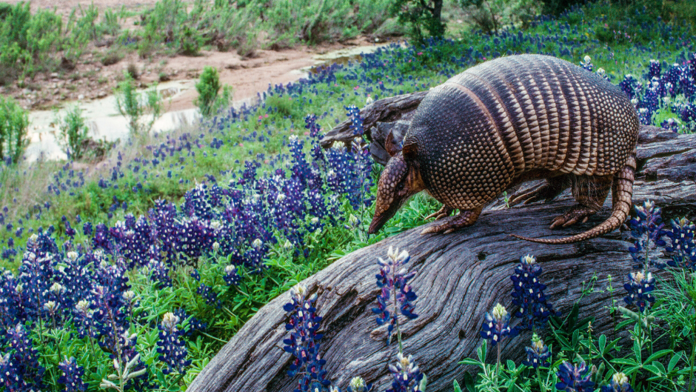
The Endangered Species of Texas and How to Find Them
Mason Womble

Slide 2
Purpose
The state of Texas hosts a considerable diversity of fauna, many of which are either endangered or threatened.
While applications and databases exist documenting such information, they lack satisfactory locational functions.
A more robust implementation of locational data would allow for individuals or groups (e.g. biologists, environmental activists, etc.) to more easily access information about regions that are relevant to their interests.
This application would seek to implement a function that made better use of locational data.

Slide 3
Database
Crafting a database from existing ecological data sources, such as the Texas Parks and Wildlife Department (TPWD) and other sources.
Database will consist of variables such as animal names (common and scientific), taxonomy (mammal, reptile, etc.), level of endangerment, and region in which the animals are found (North Texas, South Texas, etc.), assembled into a relational model.

Slide 4
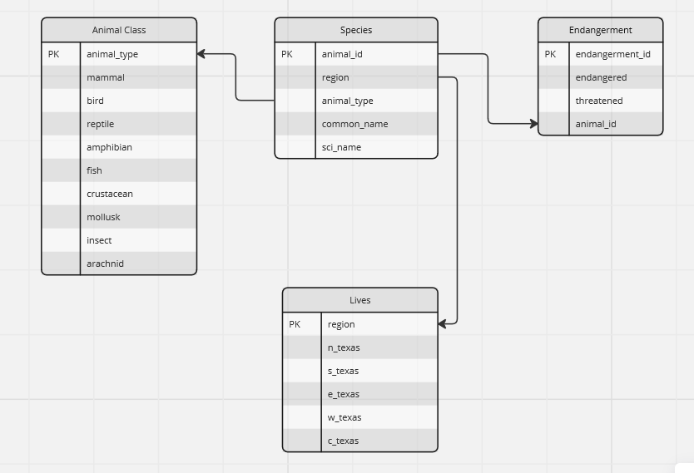

Slide 5
Web interface
The application’s web interface will provide a search bar that will allow a user to input either the common or specific name of an animal in order to find their relevant information.
It will also feature three drop-down filters allowing the user to search based on animal type, level of endangerment, or the general region.

Slide 6
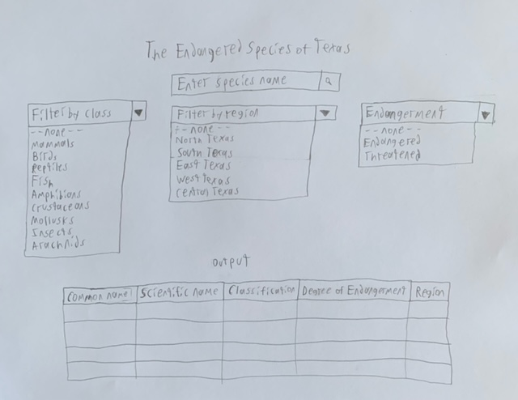

Slide 7
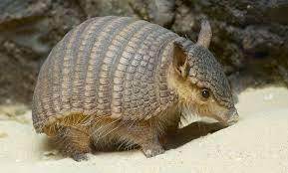
Thank you

